Slide 1
CSC/ECE 517: Object-Oriented Design and Development
Web site:
http://courses.ncsu.edu/csc517/lec/001
http://courses.ncsu.edu/ece517/lec/001
http://www.csc2.ncsu.edu/faculty/efg/517/f17

Slide 2
Major course topics
Ruby
Ruby on Rails
O-o design fundamentals and UML
O-o design principles
Design patterns

Slide 3
Syllabus: Course goals
Learn to design programs with classes that work together with maximum cohesion and minimum coupling,
Learn how design methodologies, such as CRC cards, and the Uniform Modeling Language, can be used to express the interaction betweeen program components.
Understand the differences between statically and dynamically typed object-oriented languages, and be able to program in both,
Learn how an understanding software design patterns can be used to structure programs so that they are robust and extensible, and
Appreciate how programs can be restructured ("refactored") to improve their adherence to the principles of good design.

Slide 4
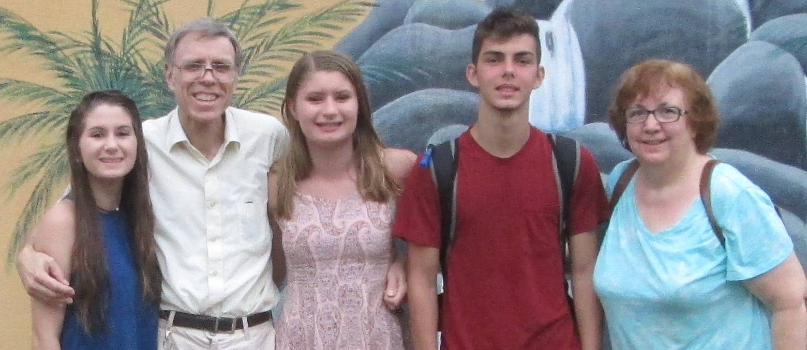
Instructor

Slide 5
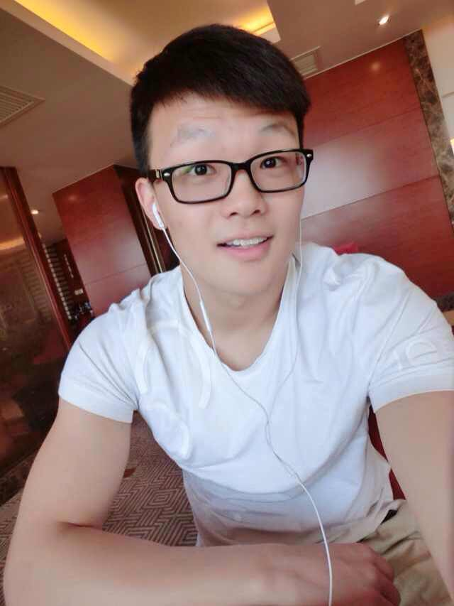
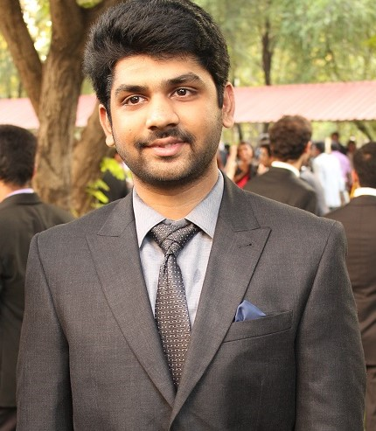
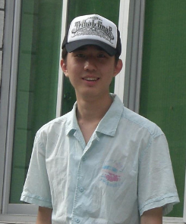
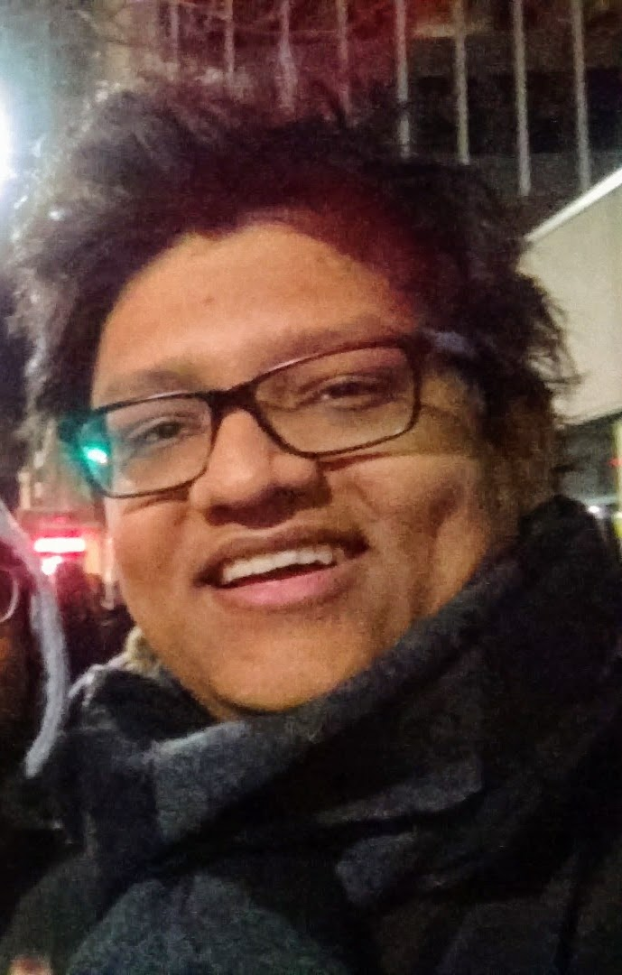
TAs
http://oit.online.ncsu.edu/online/Catalog/catalogs/rkwilker-csc-456-001-gehringer
Sarat
Kavuru
Yifan Guo
Song Ju
Anubhab
Majumdar

Slide 6
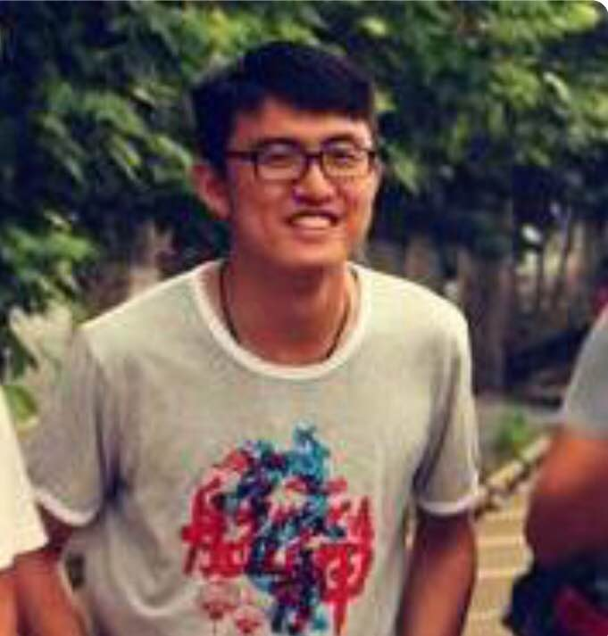
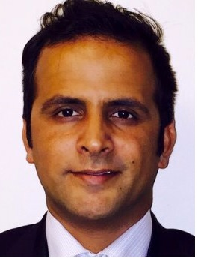

Also helping with projects …
http://oit.online.ncsu.edu/online/Catalog/catalogs/rkwilker-csc-456-001-gehringer
Zhewei Hu
Qaiss Alokozai
And players to
be named later

Slide 7

Textbook

Slide 8
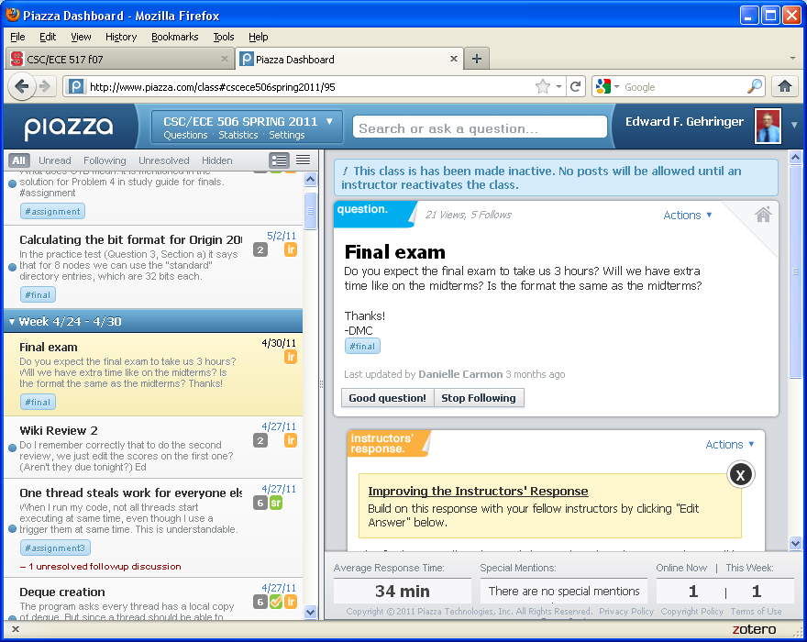
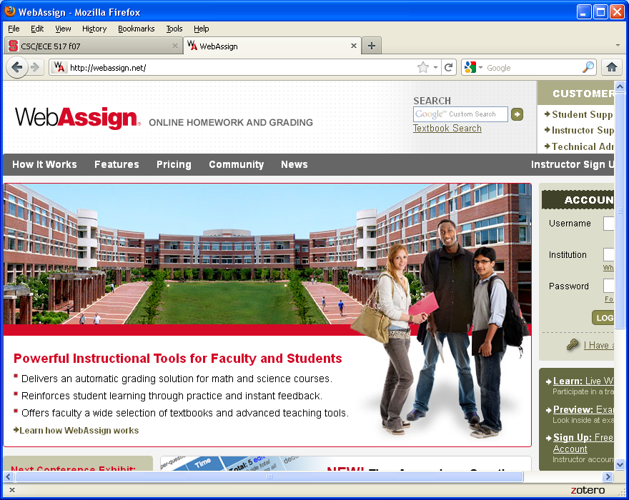
Forums
To communicate with other students
  Piazza
For quizzes
& exams
  Webassign

Slide 9
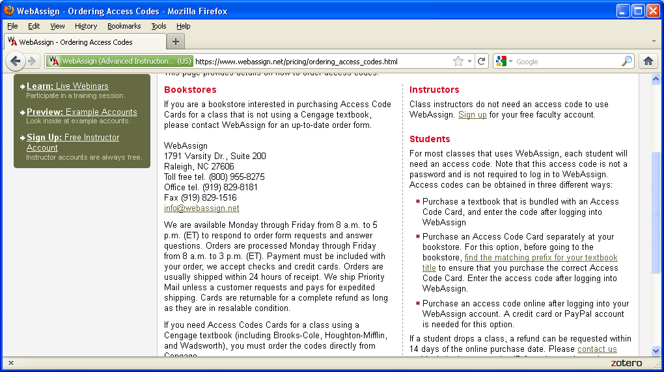
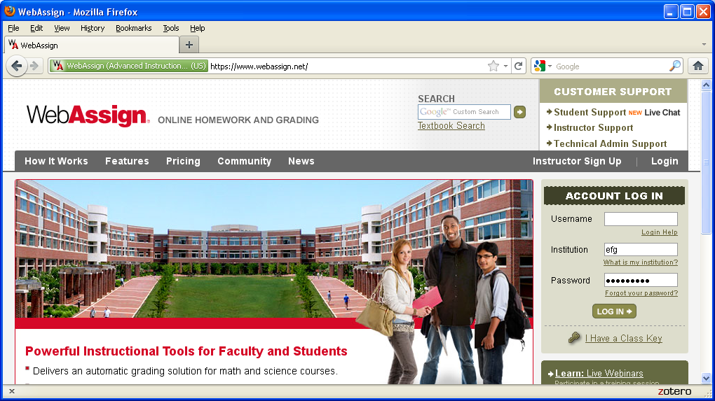
Webassign
Used for quizzes, exams
Account costs $22.95 for semester

Slide 10

“Incremental learning” requirement
Everyone responsible for learning material as it is presented.
Satisfy this by …
Passing quizzes on online material
Responding to Google forms in class

Slide 11
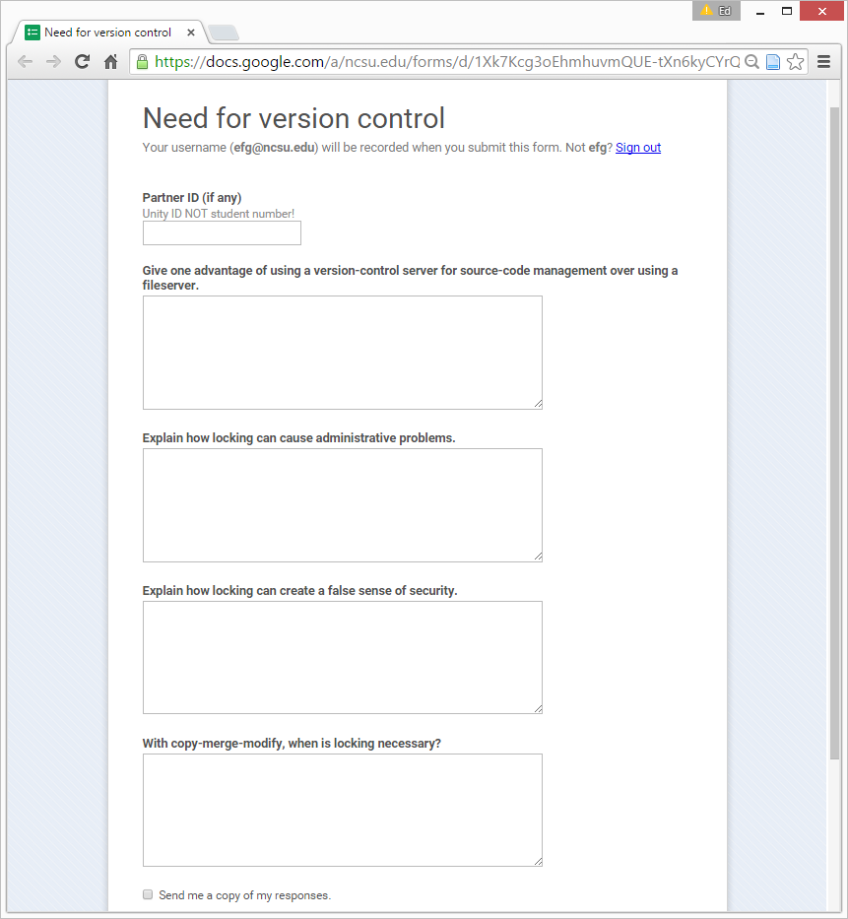
Google forms
Used to
respond to
questions
during class …

Slide 12
Audit requirement
Pass at least ½ of the weekly quizzes over online material, and
Do one homework, or take one test (not post-quiz), before fall break and score at least 50%; then
  do one homework, or take one test, after fall break and score at least 50%.
  You can choose which homework or test to take, and if you take one and fail to score 50%, you can try another.

Slide 13

Collaborative learning
Rationale Statement #1
Based on …
  Pair programming
  Agile methodologies
  Educational research

Slide 14
What’s wrong with working alone?
Industry doesn’t do it that way
Learn more from peers
Less threatening to work with others
Raises burden on TAs
So TA & I don’t do all the evaluation
Increase burden of
  interface
  integration

Slide 15

What’s wrong with working alone?
Too easy to cheat!

Slide 16
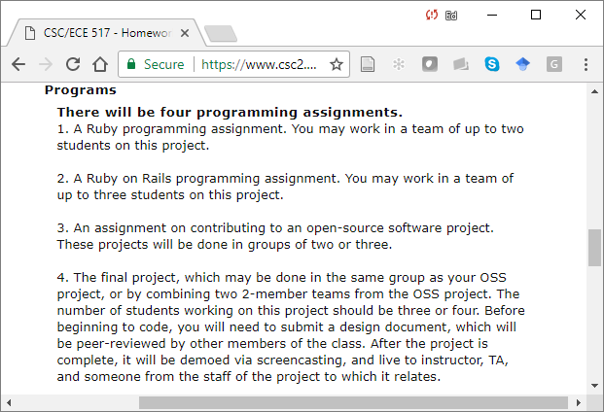
Homework: Programming

Slide 17
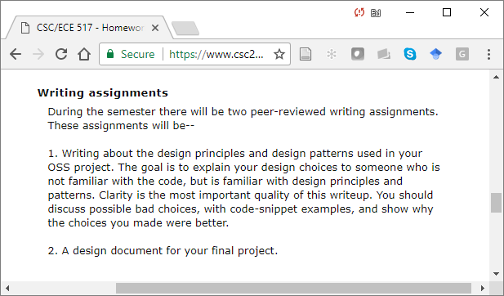
Homework: Writing

Slide 18
Teaming requirement
Work with a minimum of 6 other students during the semester
  Ruby program (Program 1)
  Rails app (Program 2)
  OSS project (Program 3)
  Semester project (Program 4)
in teams of 2
up to 3
up to 3
up to 4

Slide 19
Assignments and Grades
Grading will be by a point system
1000 pts. is full credit
  Homework 405 pts.
    4 programs
      Ruby program 35 pts.
      Ruby on Rails program 70 pts.
      OSS project 80 pts.
      Final project 140 pts.
    2 writing assignments
      Writeup on OSS project 40 pts.
      Final project design doc. 40 pts

Slide 20
Assignments and Grades
  Reviews 120 pts.
    Peer reviews 75 pts.
    2 reviews req’d. for each of 3 peer-reviewed assgts. @ 12½ pts. each
      Can do up to 2 extra reviews for 12½ pts. each
    Teammate reviews 45 pts.
  Exams 360 pts.
    Test 1 60 pts.
    Test 2 120 pts.
    Final exam 180 pts.

Slide 21
Assignments and Grades
You are required to attend 9 of 12 weeks.
  5 pts. each (for each lecture attended up to 9)
You are required to pass 13 of 14 weekly quizzes, plus the Syllabus Quiz.
  5 pts. each (for each quiz passed, up to 15).
You are required to team with 6 students.
  Each teammate you are lacking –20 pts.

Slide 22
Extra credit
General rule …
  You can receive extra credit only for contributions that help others learn
Three ways to earn …
  Extra reviews, as explained above
  Helping other teams with their OSS and final projects
  Being one of the top students in the class on answering questions on Piazza.

Slide 23
Reviewing
An important part of the semester’s work is reviewing other students.
  Please treat this responsibility seriously
    Look over work carefully.
    Give feedback that will help other improve.
  The effectiveness of your reviewing will be assessed by the course staff.
    No credit will be given for any review that doesn’t make at least 2 suggestions for how the work could be improved.

Slide 24

Feedback (in general)
We all learn from getting feedback
  IT, SN facilitates this
Daily course evaluation
Private posts in Piazza
  Please don’t post
  confrontationally!

Slide 25

Academic integrity
See http://www.csc.ncsu.edu/faculty/efg/517/f17/integrity

